Slide 1

TELEMEDICINE WITH UBERIZATION OF DOCTORS

Slide 2
AIM
To apprise audience about the impact of Telemedicine with Uberization

Slide 3




SEQUENCE
Introduction
Telemedicine with uberization
Case studies
Future

Slide 4
INTRO
TERTIARY HEALTHCARE
TEACHING HOSPITALS & SPECIALIZED HOSPITALS
SECANDARY HEALTHCARE
DHQ
THQ
Primary healthcare
BHU
RHU
DESPENSIIRES
Healthcare Structure Of Pakistan

Slide 5
Patient Overload
Increase population
Chronic disease
Sedentary lifestyle
Prime location of hospital
Increase patient load in Hospitals

Slide 6


Administrative burden
Delayed operation dates
Stressful envoirment
Disturb doctor to patient ratio
Food & travel cost
Work life imbalance
Multiple visits
Physician burnout
Increase hospital stay
Problems faced by hospital staff and patients

Slide 7
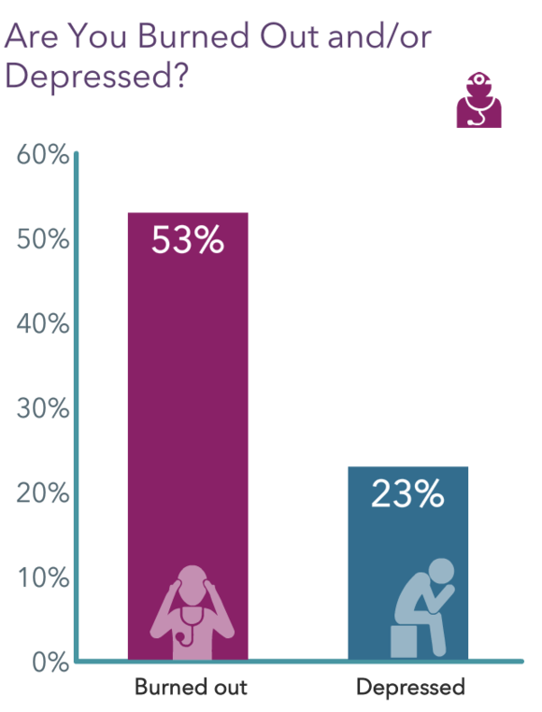
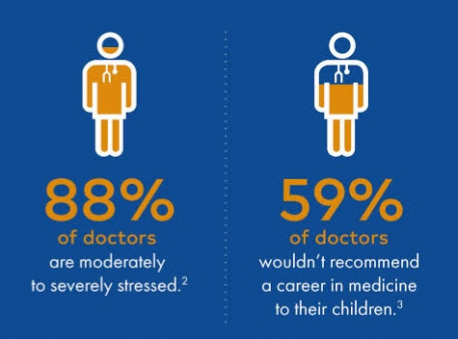
According to 2023 Medscape’ s survey 53% of physicians say they are burned out as compared to 42% in 2018

Slide 8
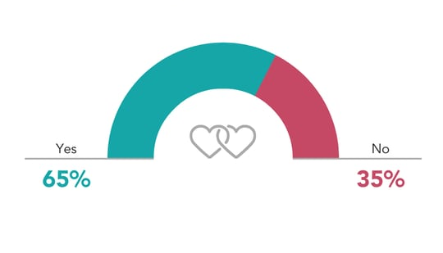


According to 2023 Medscape’ s survey 65% of physicians say their family life has effected by Patient’s Overload
Has burnout had a negative effect on your relationship with family ?

Slide 9




Doctor-to-patient ratio in Pakistan
WHO’s recommended Doctor to Patient ratio
1:1300
1:1000

Slide 10
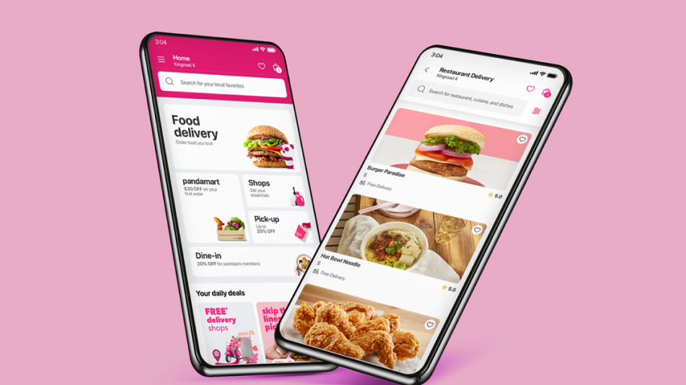




Doctor delivery
Doctor
Delivery

Slide 11

TELEMEDICINE WITH UBERIZATION
--------------------------------------

Slide 12
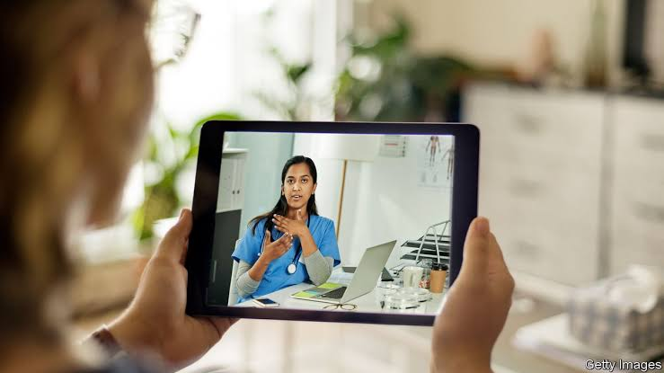

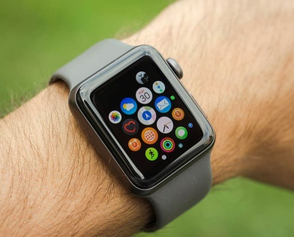
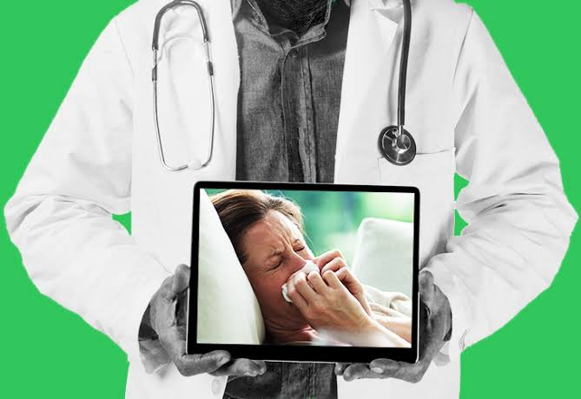
TELEMEDICINE
virtual appointment
minimize transportation expenses
Employs telecommunication tech to offer remote healthcare svc, improving access to med care
remote monitoring patients' health
Minimize Exposure to Infections

Slide 13
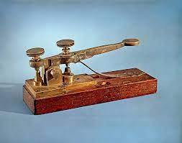


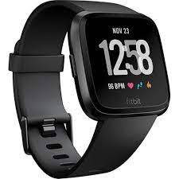
TELEMEDICINE THROUGH AGES
Telegraph
Telephone
Internet
IoT Devices

Slide 14

UBERIZATION OF DOCTORS

Slide 15
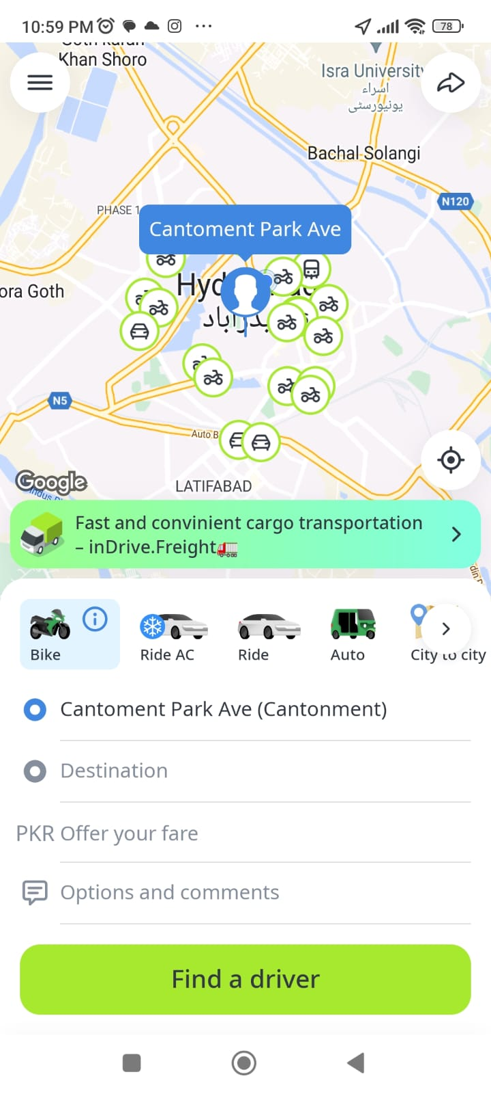


Slide 16
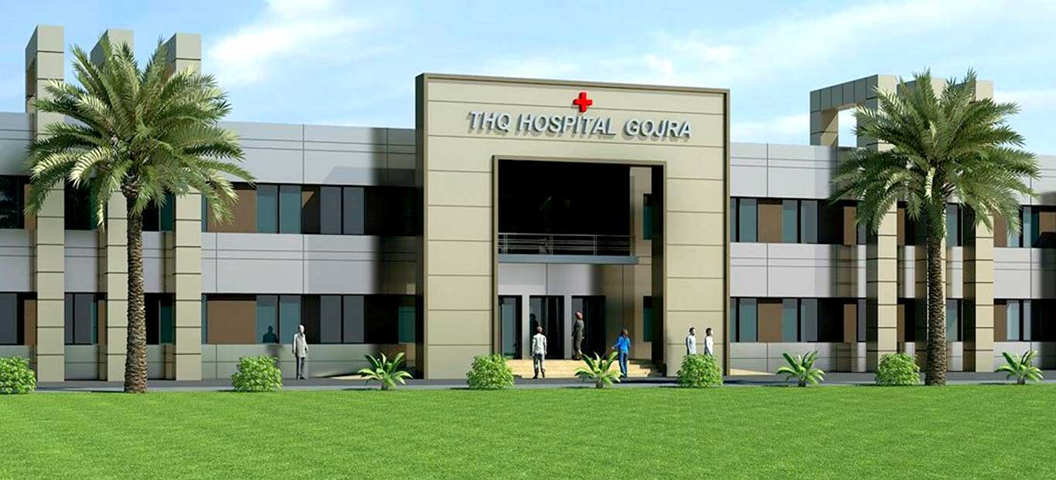
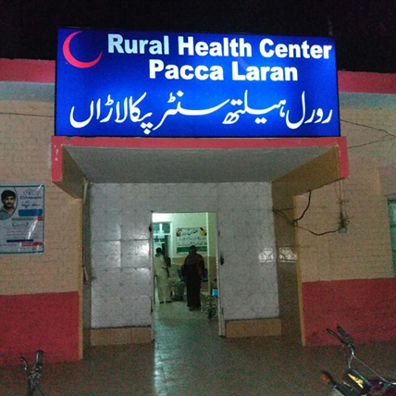
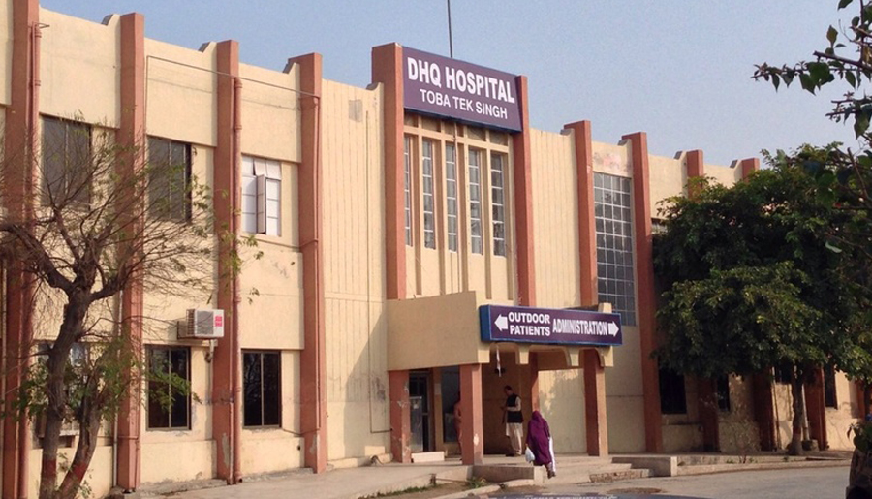

The concept of "uberization" refers to the transformation of traditional industries through the adoption of on-demand services
CONCEPT OF UBERIZATION
RMO at DHQ
Connected to
RMO at RHC
Patient arrived at THQ (occupied)
RMO at BHU

Slide 17
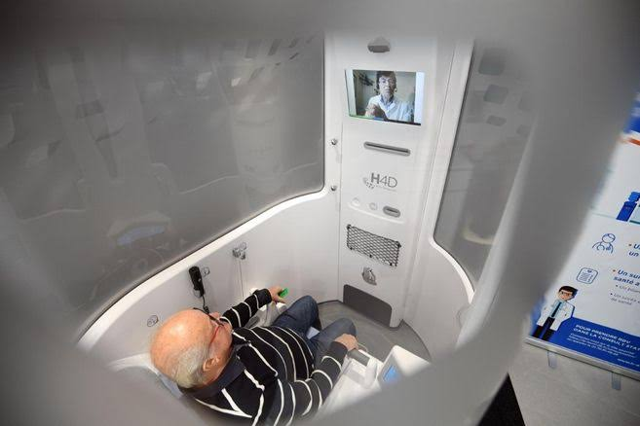
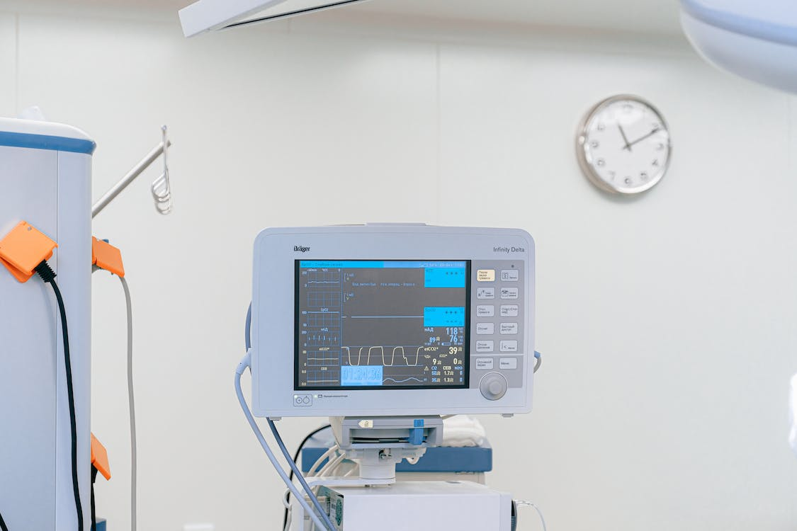


COMPONENTS
Booth
Vitals monitor
Webcam
Internet/Server

Slide 18
FLOW CHART
Patient came in A&E
Reached telemedicine booth
Vitals monitored & symptoms entered
Feedback of consulted doctor
Connected to available doctor
If critical
If stable
Referred to concerned specialist
Medicine prescribed for home

Slide 19
CASE STUDIES
Case Studies
Teladoc Health (USA)
one of the largest telemedicine providers globally
Babylon Health (UK)
partnered with the NHS to provide access to healthcare professionals and information
Sehat Kahani (Pakistan)
connects female doctors with patients, especially in underserved and remote areas
Apollo Tele-Health Services (India)
part of the Apollo Hospitals Group, one of India's largest healthcare providers

Slide 20

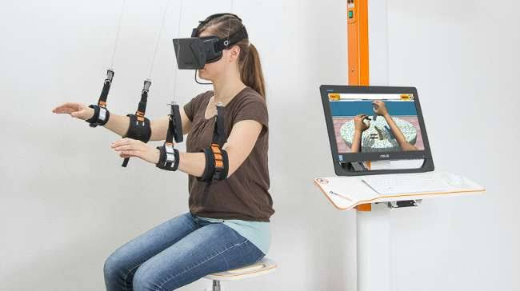
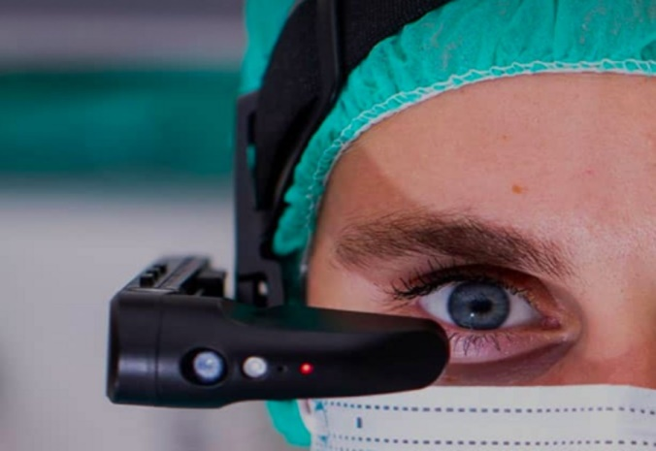
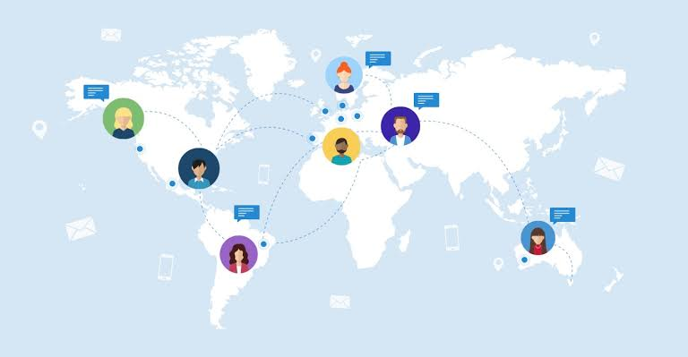
FUTURE DEVELOPMENTS
Advanced AI and Diagnostics
Virtual Reality (VR) for Training and Rehabilitation
IoT and Remote Patient Monitoring
Tele-Surgery Collaboration

Slide 21


Slide 22
REFERENCES
https://healthcare-digital.com/digital-healthcare/top-10-wearable-healthcare-devices
https://www.singlecare.com/blog/news/telehealth-statistics/
https://www.cdc.gov/nchs/products/databriefs/db445.htm
https://youtu.be/mbiAp7P8thI?si=4-xIjFRC5pbFzTN1
https://www.arabnews.pk/node/1826911/pakistan
https://www.ncbi.nlm.nih.gov/books/NBK45445/

Slide 23
REFERENCES
https://www.medscape.com/slideshow/2023-lifestyle-burnout-6016058#14
https://www.apollohospitals.com/
https://www.babylonhealth.com/
https://www.teladochealth.com/
https://sehatkahani.com/
https://www.ncbi.nlm.nih.gov/pmc/articles/PMC10332330/#REF2

